Slide 1



Retail analysis_MK
View in Power BI
Last data refresh:
12/6/2020 12:12:44 AM AUS Eastern Standard Time
Downloaded at:
12/7/2020 1:52:27 AM AUS Eastern Standard Time

Slide 2
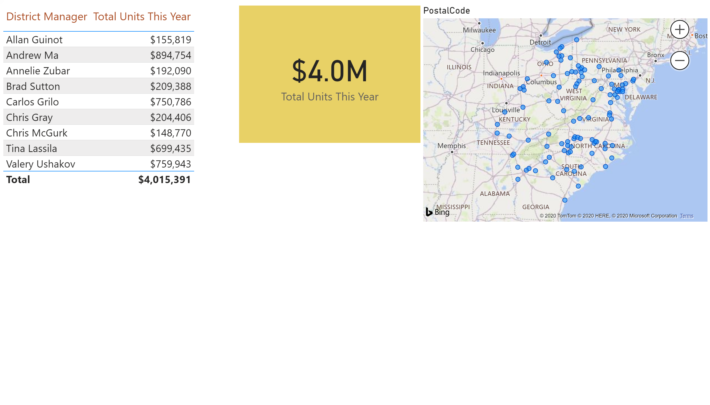

Slide 3
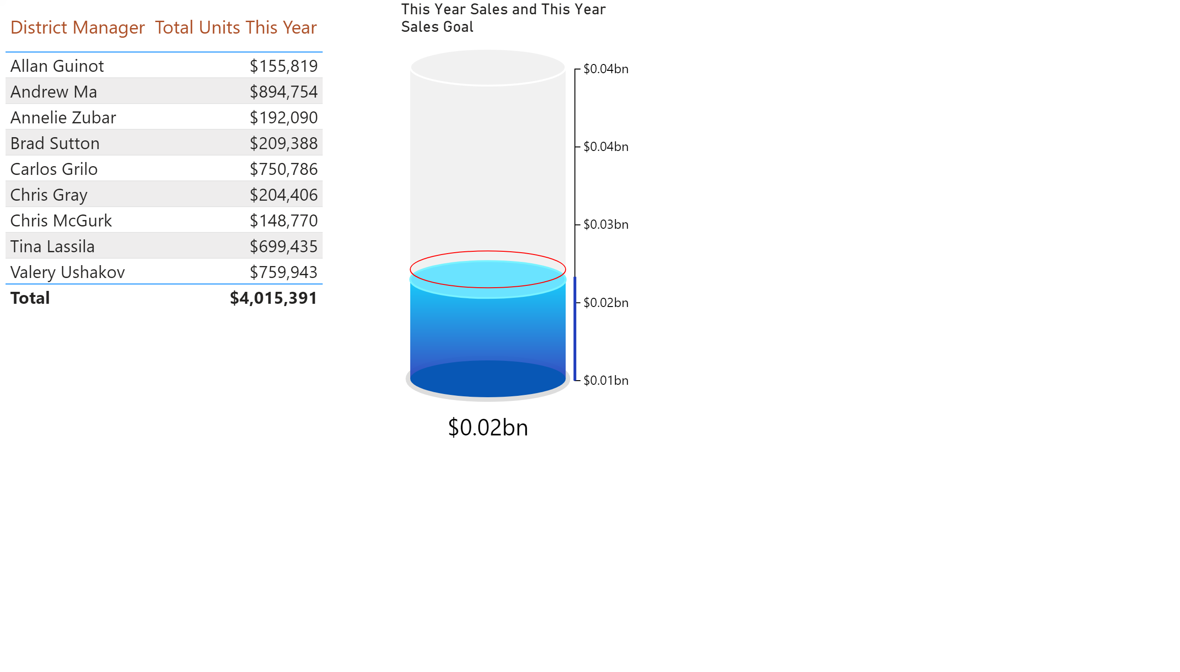

Slide 4
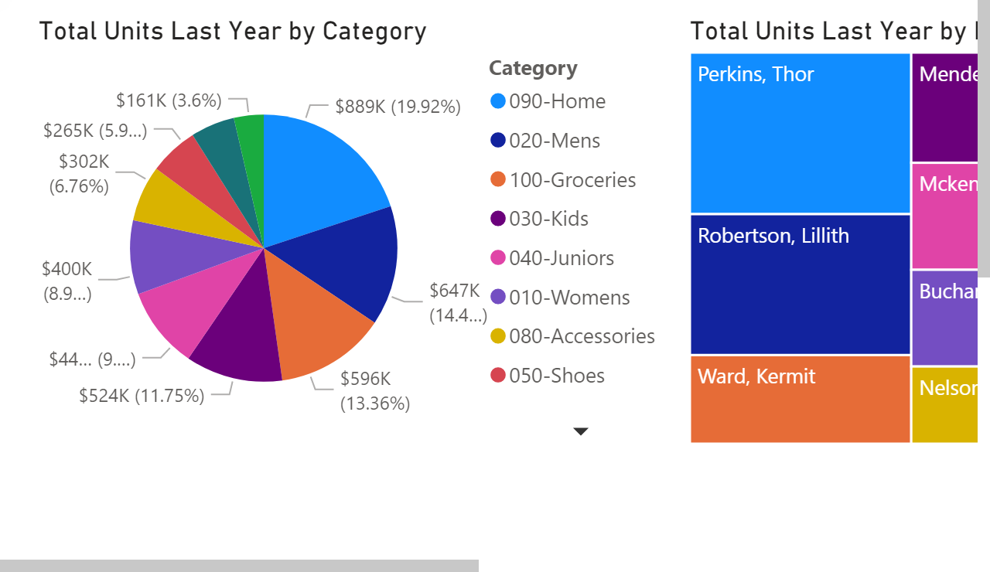

Slide 5
